Slide 1
MOVIE QUERY
Screlea Vlada
Ionescu Elena

Slide 2
The Purpose of the Project
An application that searches for movies based on it’s attributes
Tuples will be formed from the dataset using the RDF algorithm after the creation of the ontology

Slide 3
WHAT WE HAVE DONE SO FAR…
Creating a dataset containing movies from IMDB
An entry from the dataset contains the following attributes: id, title, release year, type, genres, rating, directors, actors, duration, languages
The data set was obtained by doing web scrapping in python on a library that has access to the IMDB site. For faster processing, threads were used to search and store data in parallel

Slide 4
WHAT WE HAVE DONE SO FAR…
Creating another 2 datasets containing information about actors and directors
An entry from any of the dataset contains the following attributes: id, nume_prenume, anul_nasterii, anul_decesului
The data set was obtained by extracting information from the site https://developer.imdb.com/non-commercial-datasets/

Slide 5
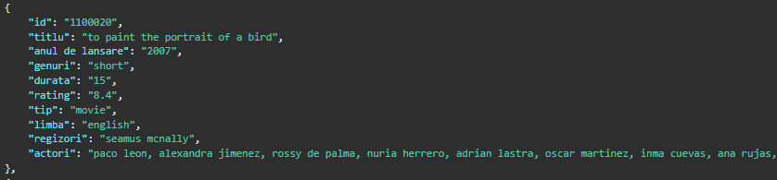
Example input from dataset
The number of entries : 36 266

Slide 6
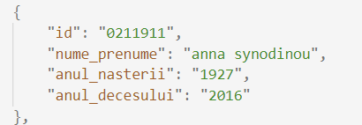
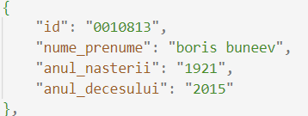
Example input from dataset
ACTORS DATASET
DIRECTORS DATASET
The number of entries : 211 913
The number of entries : 10 814

Slide 7
Our ontology
Main Entities:
1. Film - Properties:
- id: Identificator unic (string) - titlu: Titlul filmului (string) - anul_de_lansare: Anul lansării (integer) - genuri: Lista de genuri (listă de stringuri) - durata: Durata în minute (integer) - rating: Rating-ul filmului (float) - tip: Tipul (ex. film, serial) (string) - limba: Limba principală (string) - regizori: Lista de identificatori de regizori (listă de stringuri) - actori: Lista de identificatori de actori (listă de stringuri)
2. Director
- Properties:
- id: Identificator unic (string) - nume_prenume: Numele complet (string) - anul_nașterii: Anul nașterii (integer, opțional) - anul_decedării: Anul decesului (integer, opțional)
3. Actor
- Properties:
- id: Identificator unic (string) - nume_prenume: Numele complet (string) - anul_nașterii: Anul nașterii (integer, opțional) - anul_decedării: Anul decesului (integer, opțional)
Relations:
1. Directed_By: Relationship between a Film and a Director
Domain: Film
Codomain: Director
2. Played_By: Relationship between a Film and an Actor
Domain: Film
Codomain: Actor

Slide 8
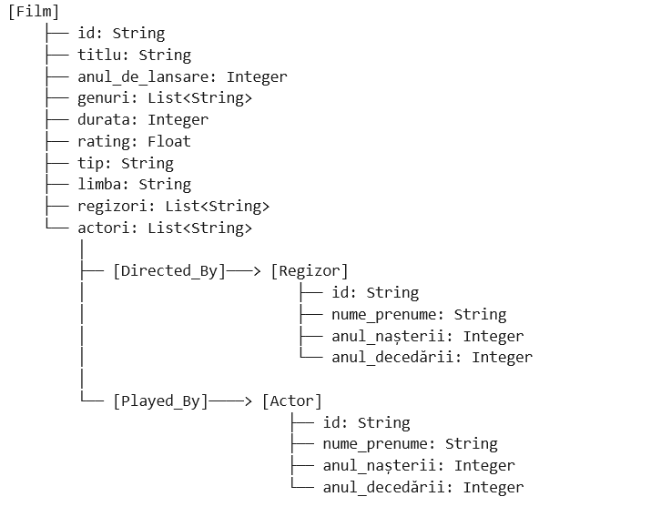
OUR ONTOLOGY

Slide 9
WHAT WE HAVE DONE SO FAR…
1. Import Libraries and Define Namespaces 2. Data Cleaning Functions 3. Reading JSON Data 4. Initialize RDF Graph 5. Creating Movie Instances 6. Creating Actor and Director Instances 7. Generate RDF Graph

Slide 10
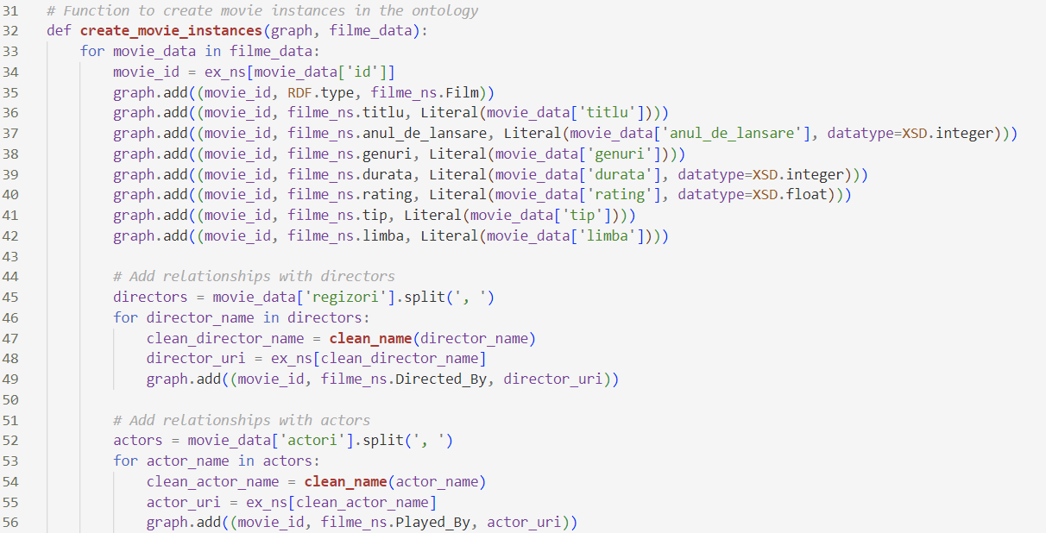
WHAT WE HAVE DONE SO FAR…

Slide 11
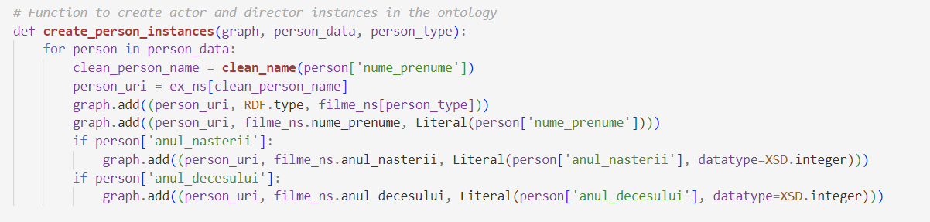
WHAT WE HAVE DONE SO FAR…

Slide 12
Problems
Problems with the generation of the dataset
Errors writing and processing RDF data

Slide 13
Thank you!
Questions?

